Slide 1

GAMES AND INTERACTIVE EXPERIENCES
FORTNITE Assets Licensing
AUGUST 2020

Slide 2

PROJECT OVERVIEW
EXPLORE. LOOT. FIGHT.
Explore a large, destructible world where no two games are ever the same. Build huge forts, find loot and squad up with friends to earn your Victory Royale.
Fortnite STATS to date​
$5 billion revenue​
350 million registered players​
78 million peak MAU​
6 million viewers across YouTube and Twitch​
PARTNER
RELEASE
GAME GENRE
PLATFORMS
DEMOGRAPHIC
BATTLE ROYALE
13+
Fortnite Players​
Disney & 20thC Fans
Epic Games
Holiday 2020
PC/CONSOLE MOBILE

Slide 3
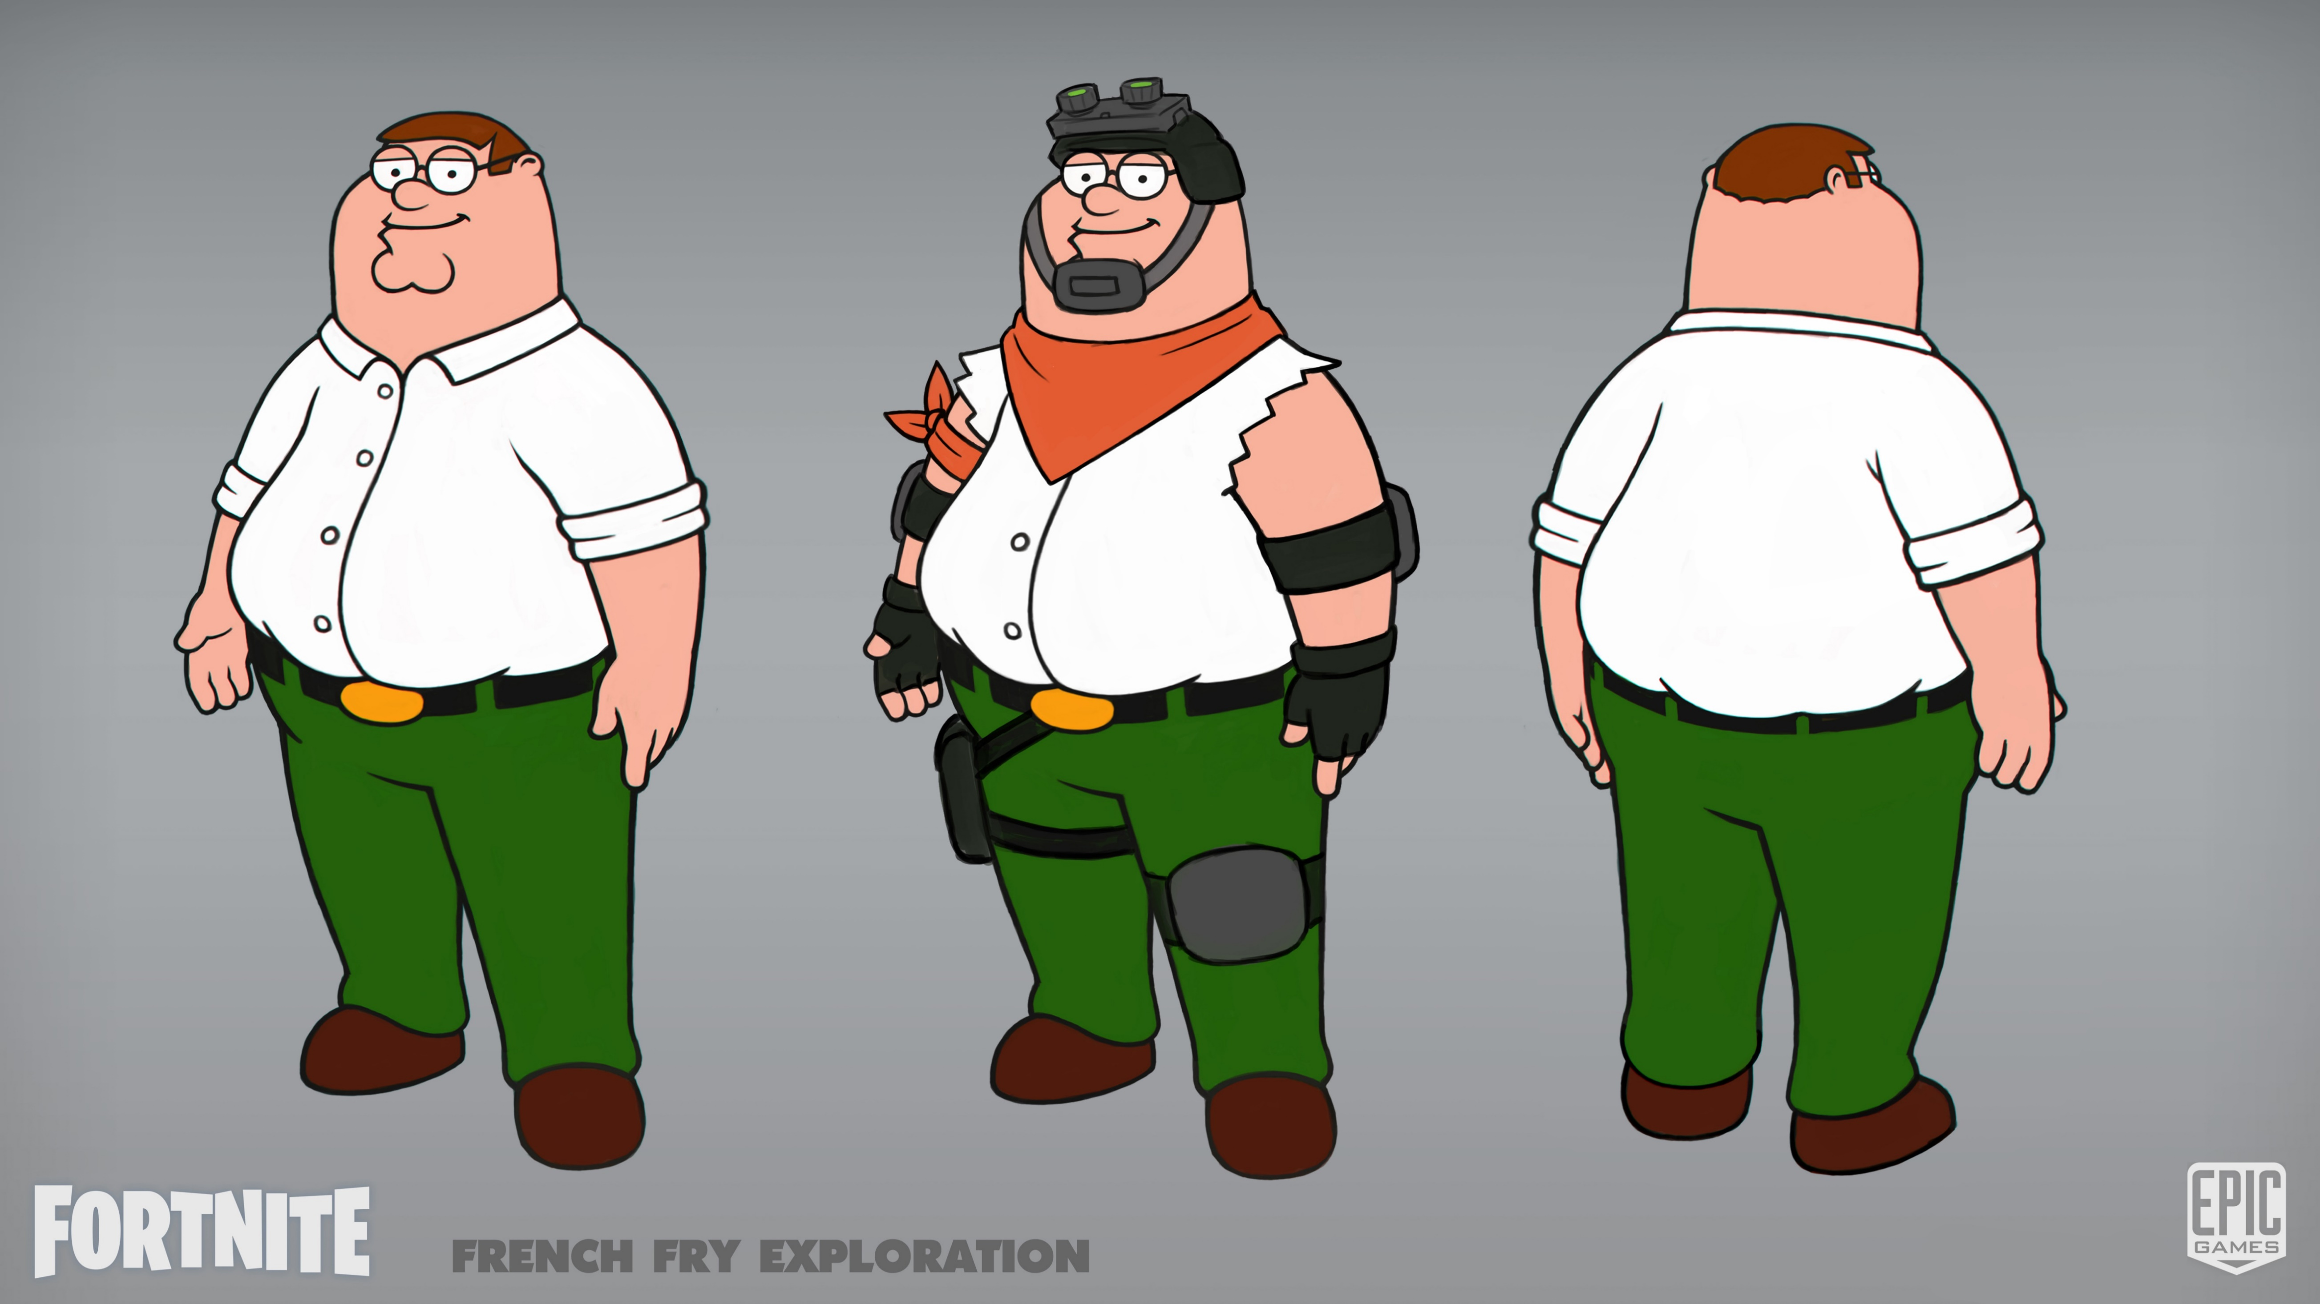
FAMILY GUY INTEGRATION - Peter Griffin Concept Art

Slide 4
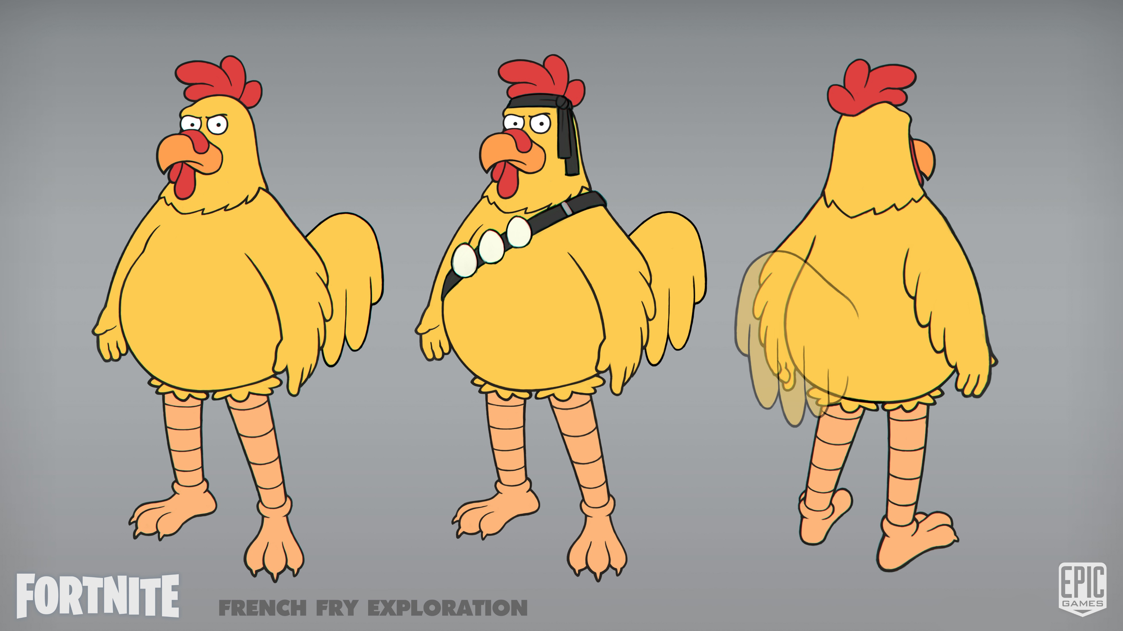
FAMILY GUY INTEGRATION - Giant Chicken Concept Art

Slide 5
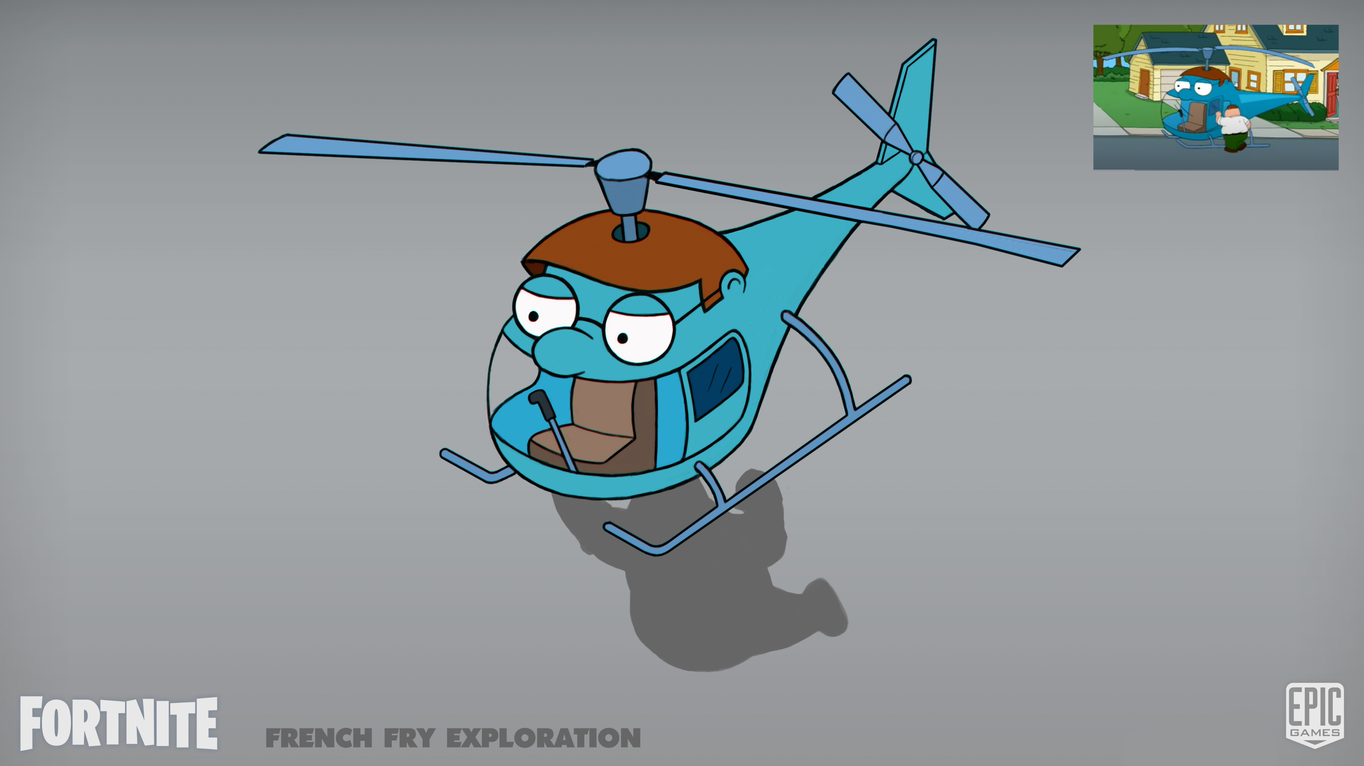
FAMILY GUY INTEGRATION - Glider Concept Art

Slide 6
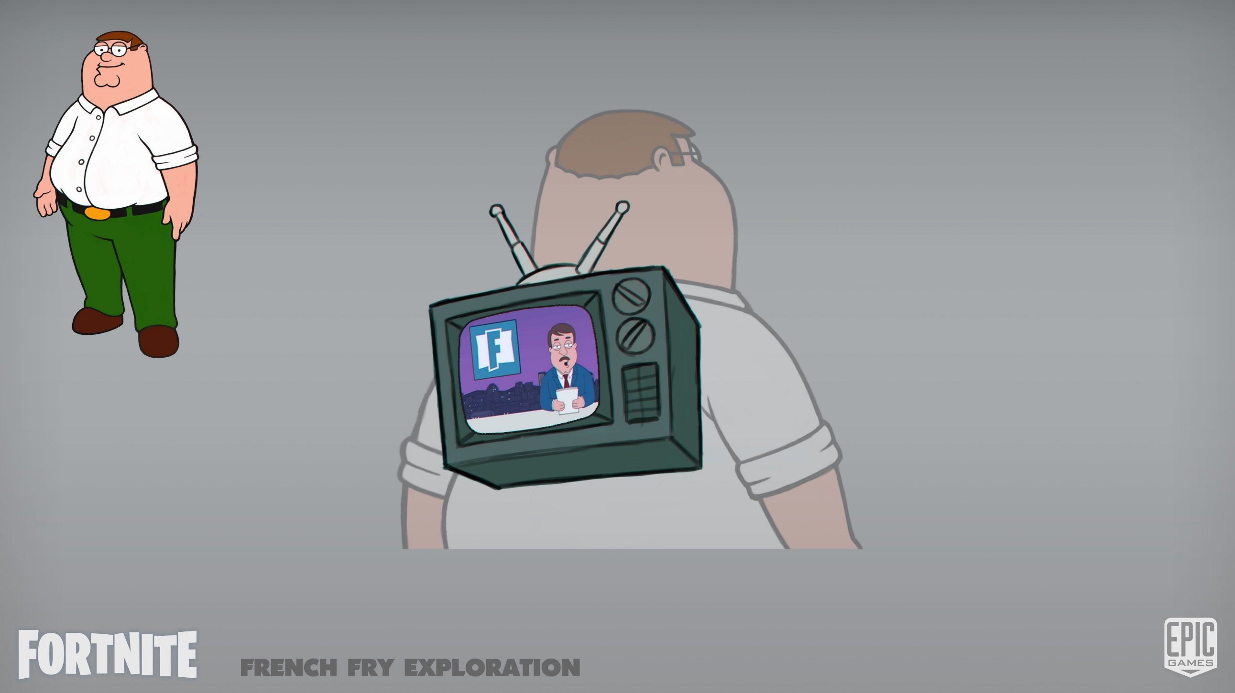
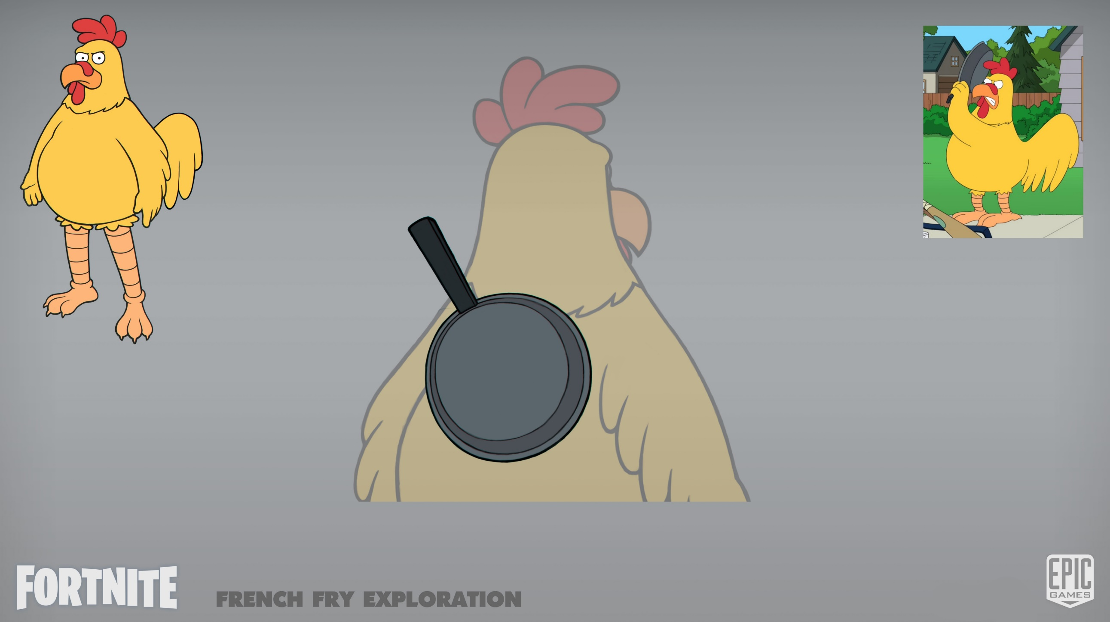
FAMILY GUY INTEGRATION - Backpack Concept Art
BACKPACK CONCEPTS

Slide 7
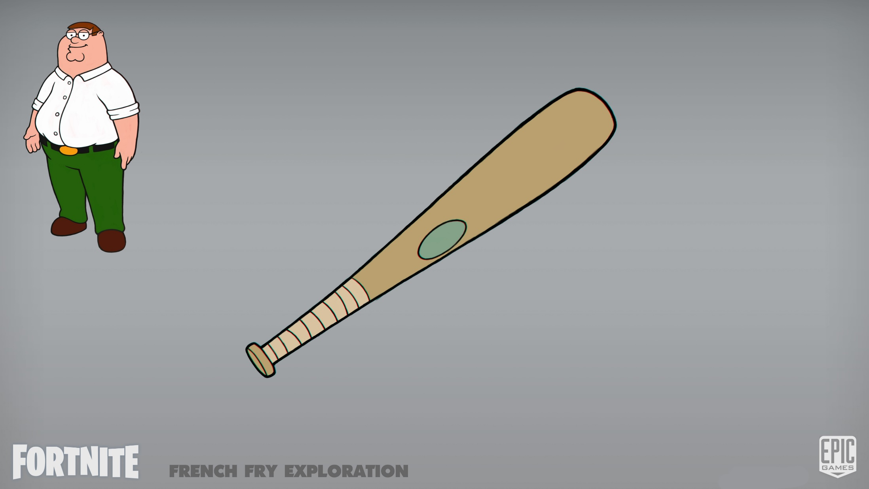
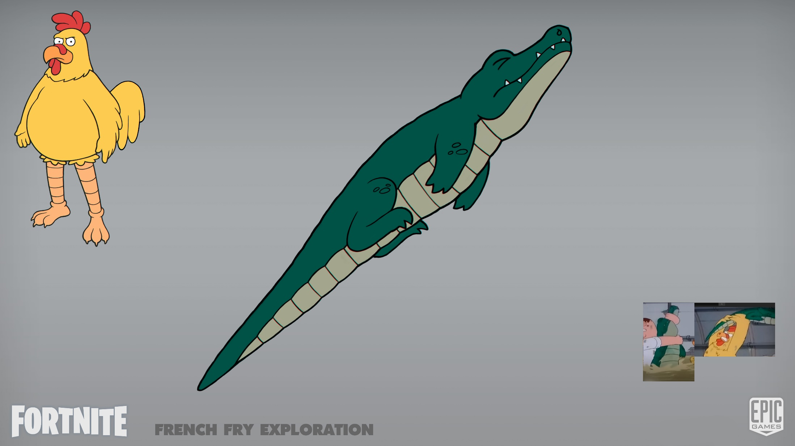
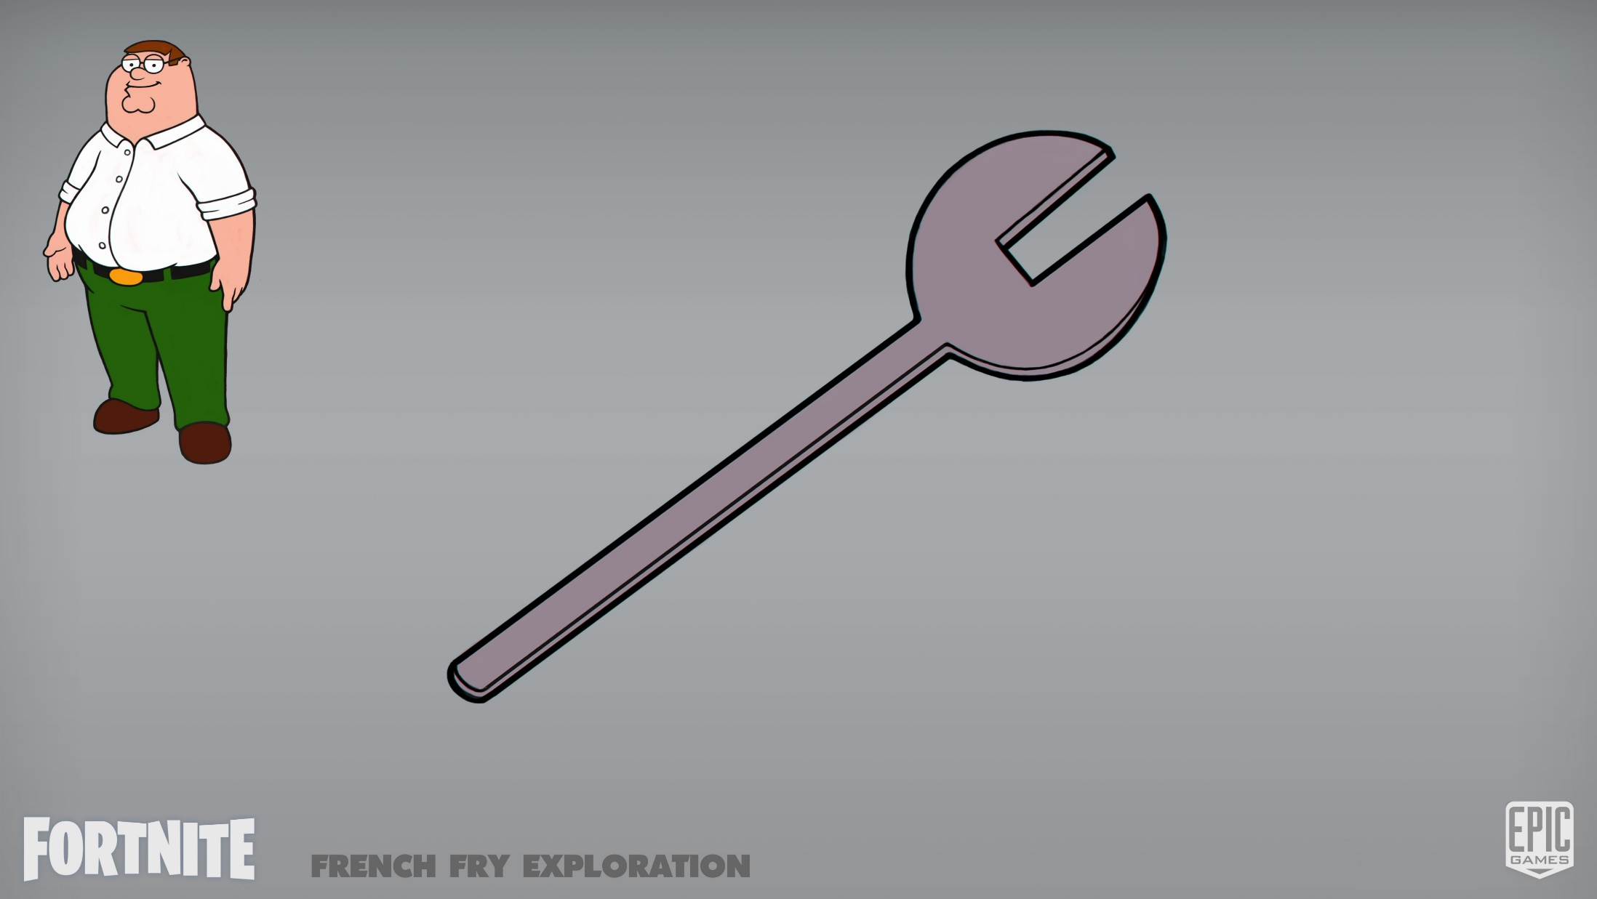

FAMILY GUY INTEGRATION - Pickaxe Concept Art
PETER CONCEPTS 1 & 2
CHICKEN CONCEPTS 1 & 2

Slide 8
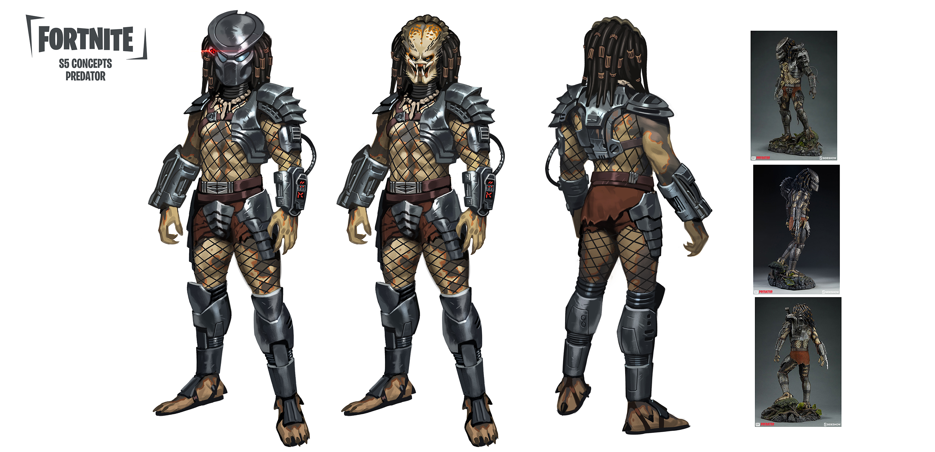
PROJECT ART – Predator: Early Exploration
FIRST PASS ART SUBMISSION FROM EPIC

Slide 9
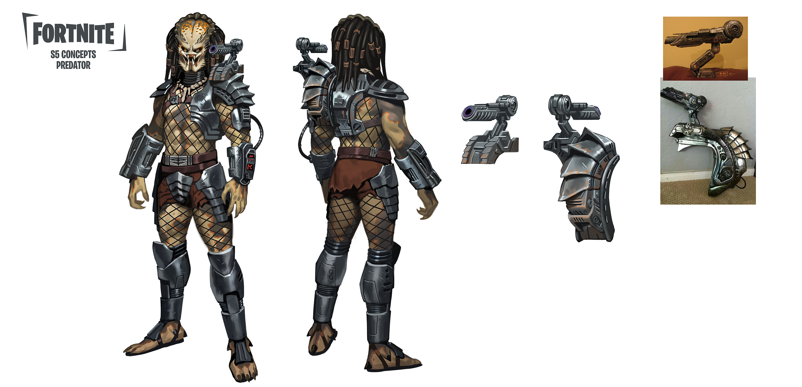
PROJECT ART – Predator: Early Exploration
FIRST PASS ART SUBMISSION FROM EPIC

Slide 10
PROJECT ART – Die Hard: Early Exploration
FIRST PASS ART SUBMISSION FROM EPIC

Slide 11
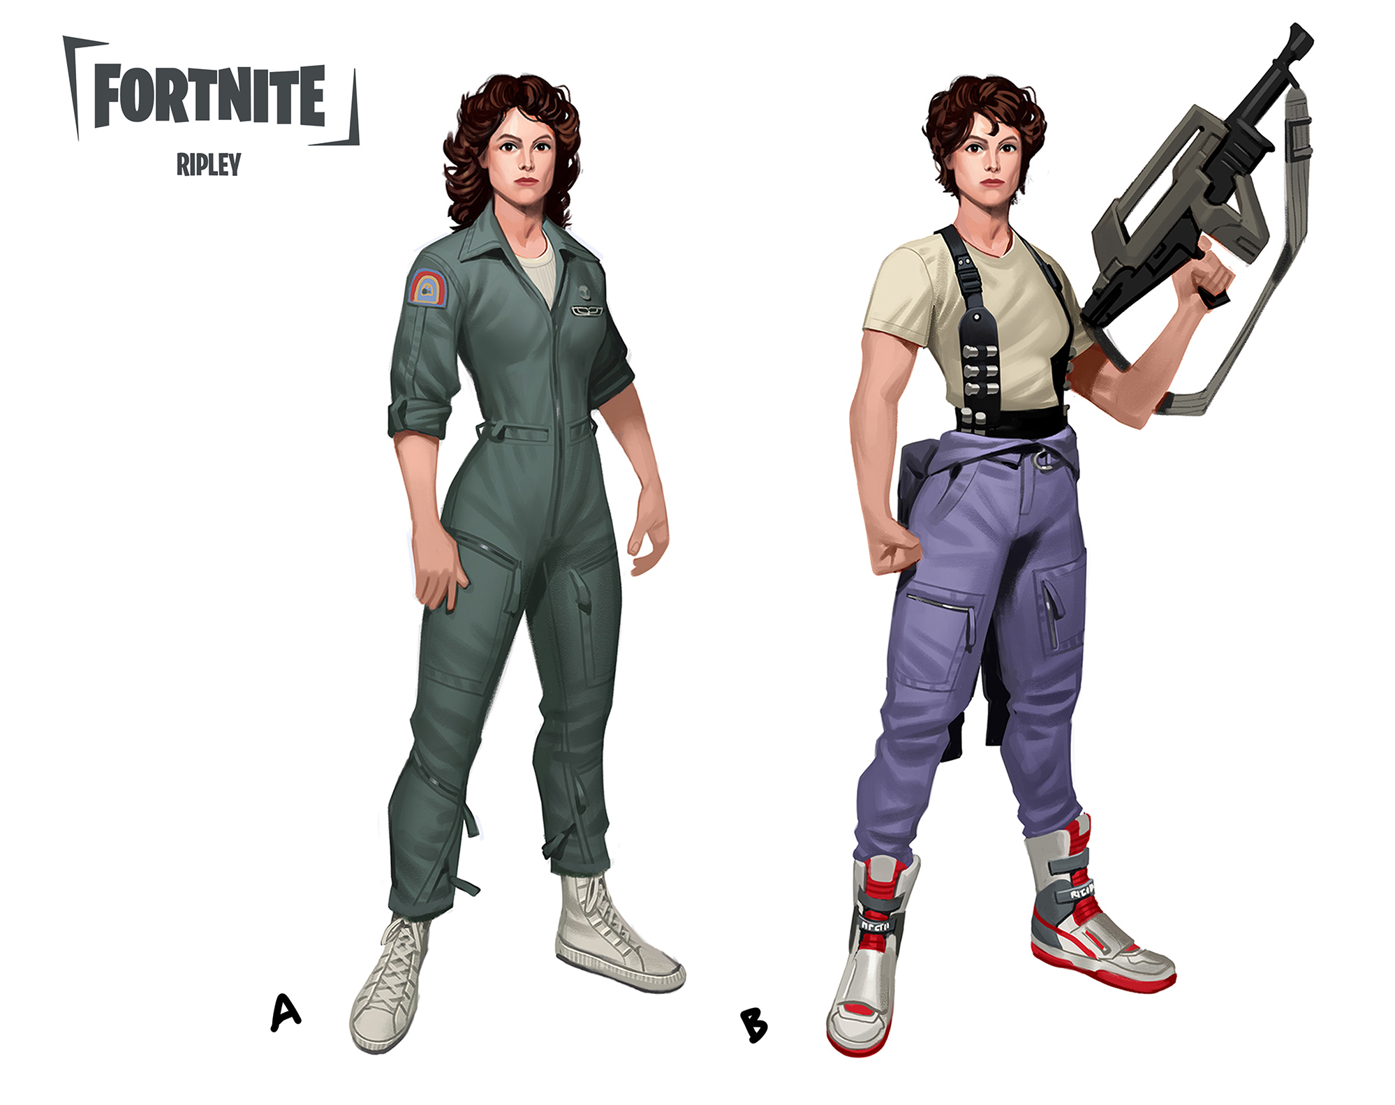
PROJECT ART – Alien: Early Exploration
FIRST PASS ART SUBMISSION FROM EPIC

Slide 12
GAMES AND INTERACTIVE EXPERIENCES
THANK YOU!

Slide 13
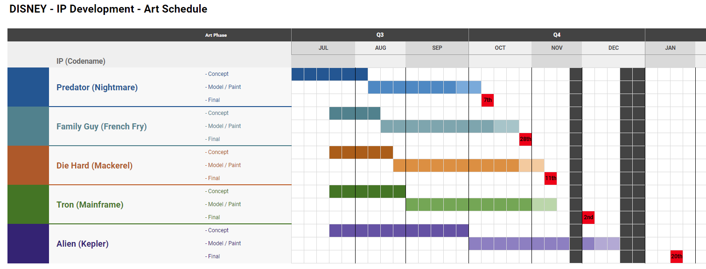
PROJECT TIMELINE

